Slide 1

The Data Act:
What It Is and What It Means
Karen F. Lee
Chief,
Federal Financial Systems Branch
Office of Management and Budget
Christina Ho
Acting Deputy Assistant Secretary
Accounting Policy
U.S. Department of the Treasury
Data Transparency Town Hall
September 26, 2014

Slide 2

Agenda
DATA Act Summary
Requirements and Approach
Treasury/OMB Data Transparency Vision
Benefits and Challenges
Next Steps

Slide 3
Federal Financial Transparency History
Federal Funding Accountability and Transparency Act (FFATA)
Recovery Act
Government Accountability and Transparency Board (GATB)
Data Accountability and Transparency Act (DATA Act)

Slide 4
DATA Act Summary
Purpose: to establish government-wide financial data standards and increase the availability, accuracy, and usefulness of Federal spending information.
Passed Congress on April 28. Signed into law on May 9, 2014 (P.L. 113-101).
Amends the Federal Funding Accountability and Transparency Act (FFATA) to require full disclosure of Federal agency expenditures.
Requires the development of Government-wide data standards, takes steps to simplify financial reporting, and improves the quality of the spending data.

Slide 5
Governance and Implementation Structure
Executive Steering Committee – OMB and Treasury
Inter-Agency Advisory Committee – OMB, Treasury, OSTP, GSA and
Representatives from: CFOC, BOAC, ACE, COFAR, CAOC, CIOC, PIC
Lead
Treasury
(Data Transparency PMO)
OMB
Design and Implement
Treasury
Data Exchange Standards
OMB
Data Definition Standards
Support
Industry
Non-Federal stakeholders
Consult
Treasury
Data Analytics
Senior Accountable Officials from each of the 24 CFO Act agencies
Federal Lines of Business
OMB
Pilot to Reduce Admin Burden
Treasury
Blueprint/roadmap between data elements

Slide 6
DATA Act
Implementation Approach
Data-centric
Avoid massive system changes, focus on managing data
Release data as it becomes available
Maximize and leverage use of existing processes and investments
Feedback drives improvements
Conduct many small scale pilots
Incremental
Reuse
Collaborative
Iterative/Agile

Slide 7
Data Definition Standards
Importance Other elements of DATA Act are dependent on data standards Affects all stakeholders and downstream recipients of Federal funds Goals
Standardize data definitions – collaborate with Federal and non-Federal stakeholders to define common data elements across communities Look at industry standards – during implementation, carefully examine common practices and uses to maximize positive impact Consider implications – use collaboration tools and outreach processes to understand and consider potential implications for stakeholders in their future reporting and compliance based on standards
Accomplishments-to-date
Compiled list of FFATA and DATA Act elements which must be defined according to DATA Act
Established Interagency Advisory Committee (IAC) to coordinate cross-community collaboration within Federal government
PRE-DECISIONAL/FOR DISCUSSION PURPOSES ONLY

Slide 8
Background –Vision:
360 Spending Life Cycle
Vision
Provide reliable, timely, secure, and consumable financial management data for the purpose of promoting transparency, facilitating better decision making, and improving operational efficiency.
Better Data, Better Decisions, Better Government
Goals
Capture and make available financial management data to enable the data consumers to follow the complete life cycle of Federal spending -- from appropriations to the disbursements of grants, contracts, and administrative spending Standardized information exchanges – definitions and format – to enable timely access to discoverable and reusable detail transaction level data
Accomplishments-to-date
Assumed program responsibility over USAspending.gov
Successfully piloted “Intelligent Data” prototype
Conducted “Award ID linkage” feasibility study
PRE-DECISIONAL/FOR DISCUSSION PURPOSES ONLY

Slide 9
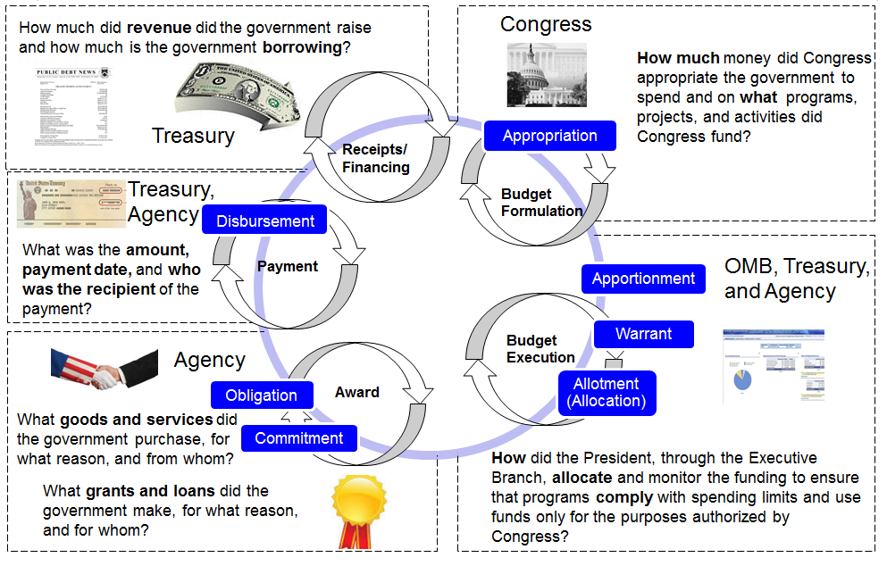
360° Spending Transparency

Slide 10
DATA Act in Context of Spending Life Cycle
Receipts/
Financing
Appropriation
Payment
Apportionment
Obligation
Allotment
(Allocation)
 | 360 Spending Life Cycle
 | DATA Act
 | FFATA (USAspending.gov)
Award
Commitment

Slide 11
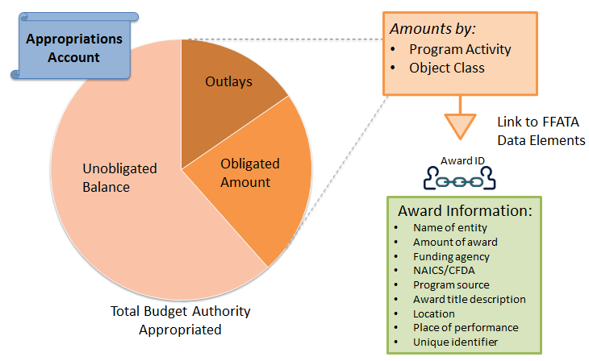
DATA Act Requirements FFATA Sec. 3 “Full disclosure of federal funds”

Slide 12
Data Sources
Treasury Data
Summary level
Operational & Reporting
Transactional level
Financial Mgmt. & Budgeting
Agency Award Data
Management system data
(i.e., procurement, grant systems)
Agency Financial Data
Appropriations account
Budgetary resources
Amount obligated
Unobligated balance
Outlays
Standard Data Exchange
Object class
Program activity
Award ID
Recipient
Location
Notes:
To meet the DATA Act requirements and our long-term goal (360 spending lifecycle), we need access to three sets of data:
Award data (recipient, location, purpose, etc.) that is currently only housed within the management systems at agencies.
Agency financial data (object class, program activity) that is currently only housed within the financial systems at agencies.
Summary account data (outlays, unobligated balances, appropriation accounts, payment) that is current stored at Fiscal Service as well as agencies.
We want to access the data in a way that is least burdensome to agencies, creates the most value to agencies, most expedient and practical.

Slide 13
Challenges
Requires strong leadership from Treasury and OMB to lead transformational changes and innovative thinking
Short implementation timeline – requires fast, early action and reporting on results
Limited resources – no additional funding for implementation
Requires collaboration and active participation across federal communities, including procurement, grants, financial management, budget
Diverse and broad set of stakeholders including, Congress, state & local governments, private industry, general public, transparency advocacy groups, and international community
Notes:
Additional expenditures information on USAspending
Sec 3 requires the Secretary of the Treasury, in consultation with the Director of the Office of Management and Budget (OMB), to post on the USAspending.gov website the following information for funds made available to or expended by a Federal agency:
(1) for each appropriations account – the budget authority appropriated, the amount obligated, the unobligated balances, and any other budgetary resources;
(2) the amounts obligated and outlayed for each program activity;
(3) the amounts obligated and outlayed for each object class; and
(4) for each program activity, the amounts obligated and outlayed by object class.
Treasury has three years after the date of enactment of the DATA Act to first post this information and is then required to post information on a quarterly basis, and, where practicable, on a monthly basis.
Financial data standards
REQUIREMENTS.—The data standards established shall:
1) incorporate widely accepted common data elements, such as those developed and maintained by—
(A) an international voluntary consensus standards body;
(B) Federal agencies with authority over contracting and financial assistance; and
(C) accounting standards organizations;
(2) incorporate a widely accepted, nonproprietary, searchable, platform-independent computer3
readable format;
(3) include unique identifiers for Federal awards and entities receiving Federal awards that can be consistently applied Government-wide;
(4) be consistent with and implement applicable accounting principles;
(5) be capable of being continually upgraded as necessary;
(6) produce consistent and comparable data, including across program activities; and
(7) establish a standard method of conveying the reporting period, reporting entity, unit of measure, and other associated attributes.

Slide 14
What is Ahead of Us?
Finalize the plan to implement the DATA Act
Consult with public and private stakeholders in establishing the data standards
Standardize the data element definitions
Develop a blueprint of the data elements based on the standard definitions
Continue pilot efforts on data exchange standards and publication options, and on reducing reporting burden
Notes:
Data Transparency Town Hall is a first step in what will be ongoing engagement
Presentations from today will be made available
Public will be able to submit comments after Town Hall
Collaborative technology tools are being considered

